Slide 1
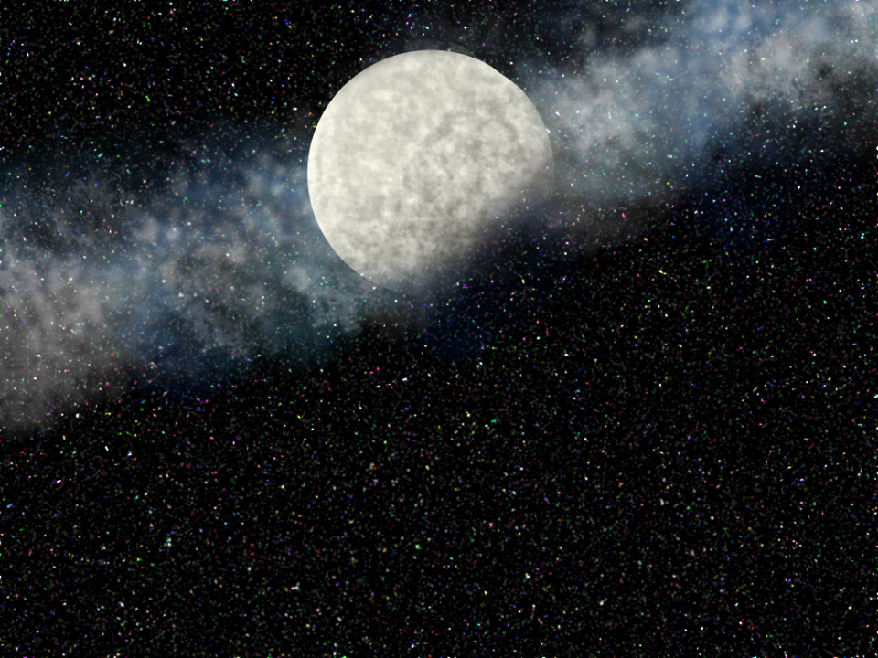
2D Projectile Aiming AI
Jack Malvey

Slide 2

Basics
Don’t aim for the Target.
Slowly modify your physics data each update to move to the same point as the target.
-OR-
Calculate where the target will be by the time the projectile will reach it, and aim to intercept it.

Slide 3
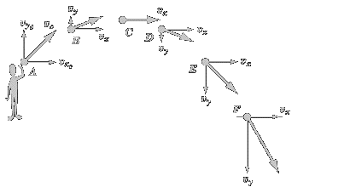
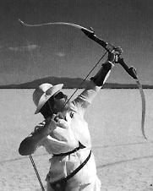
Iterative Physics
Get the distance between the target and the projectile and divide that by the projectile speed
Iterate the target’s position by adding the initial velocity(multiplied by the iterator from step 1) to the initial position
Get the distance between the target’s new position and the initial projectile position
Move towards the Normalized difference between the target’s current position and the projectile’s initial position
Rinse and repeat until collision

Slide 4
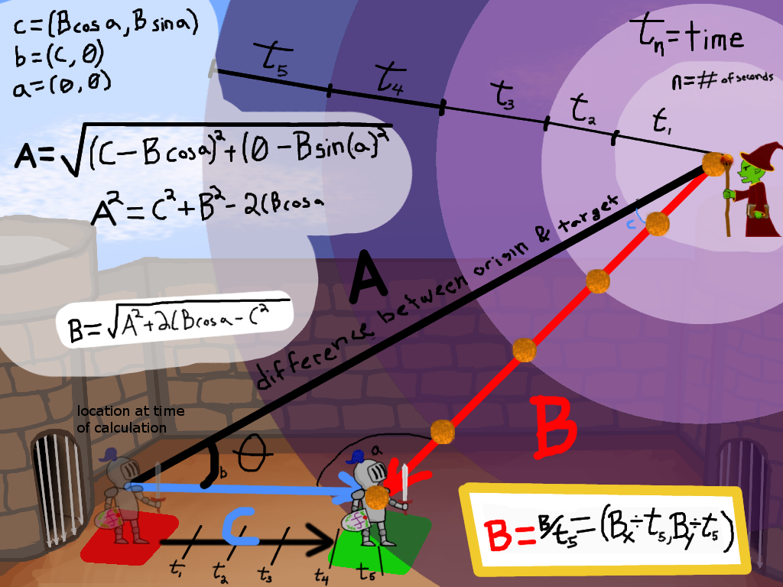
Pre-calc…ulated physics
Use advanced trigonometry to calculate an intersection point for the target and the projectile.
Remember the Law of Cosines?

Slide 5
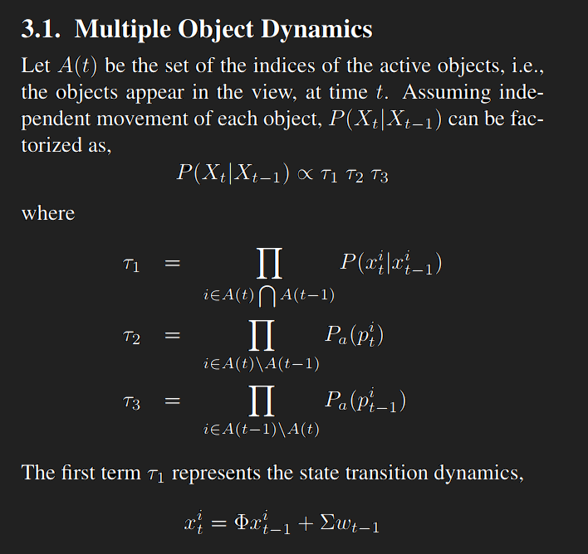

Advanced Tracking
Han, Mei, et al. An Algorithm for Multiple Object Trajectory Tracking. NEC Laboratories America, Cupertino, citeseerx.ist.psu.edu/viewdoc/download?doi=10.1.1.91.1102&rep=rep1&type=pdf

